Slide 1


DEPARTMENT OF COMPUTER SCIENCE AND ENGINEERING
20CS7503 & DESIGN PROJECT 3
END SEMESTER PRATICAL EXAMINATION – NOV / DEC 2025
Batch No.: 10
Date:29/10/2025
Session: FN
1

Slide 2
ONLINE AUCTION AND BIDDING ADMINISTRATION SYSTEM
Guide Name:
MR.R. RAJAVARMAN Hod/CSE
Team Members:
P. KABILAN (811722104066)
D. KEVIN JACOB (811722104075)
K. KEVIN JOEL (811722104076)

Slide 3
OBJECTIVE OF THE PROJECT
1. Auction Listings & Bidding:
Sellers list products/services with details like price, description, and images, while buyers place bids with real-time updates on the highest bid.
2. Auction Management:
Sellers or admins set auction start and end times, along with bidding rules. The highest bidder is automatically select as the winner when the auction ends.
3. Secure Transactions:
Buyers and seller's complete transactions using secure payment methods for safety.
4. Security Measures:
Protections are in place to prevent fake bids, fraud, and unauthorized access.

Slide 4
INTRODUCTION
1. Traditional auctions often face challenges like limited accessibility, lack of transparency, and time constraints.
2. With the rapid growth of digital platforms, there is a strong need to modernize the auction process.
3. It enables sellers to list products and buyers to place bids in real-time with features like:
User authentication and role-based access
Real-time bidding and bid history
Secure transactions and notifications

Slide 5
LITERATURE SURVEY
TITLE | AUTHORS | PUBLISHER | TECHNOLOGY USED
Auction as a Method of Privatization of State Property | Imomniyozov Doniyor Bakhtiyorovich | International Journal of Economic Research (2024) | Auction mechanisms for privatization of state property
Auction Bidding Platform for Buying and Selling Goods using Full Stack | Dr. M. Ekambaram Naidu | International Journal of Computer Applications (2024) | Full Stack Development (Web-based Auction Bidding Platform)
A Study on Online Auction System Using Machine Learning Techniques | A. S. Rani and S. Ramya | Journal of Advanced Research in Computer Science (2023) | Web-based Auction System (General implementation in online environment)
Development of Real-Time Online Auction System Using WebSocket Protocol | S. Kavitha and R. Nagarajan | International Journal of Computer Science and Mobile Computing (2023) | WebSocket Protocol (Real-time Online Auction System)

Slide 6
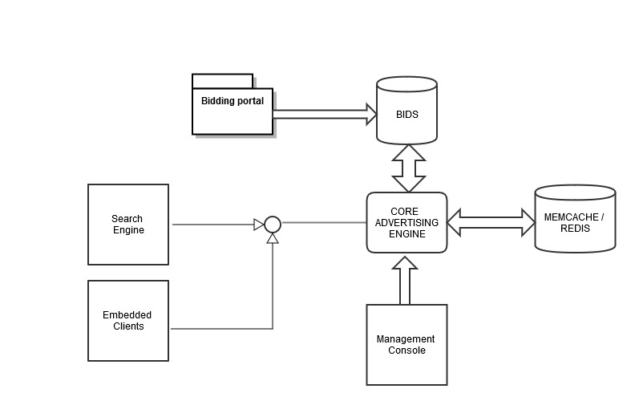
EXISTING SYSTEM ARCHITECTURE

Slide 7
PROBLEM IDENTIFICAITON
1. Limited Accessibility:
Physical auctions require participants to be present at a specific location and time, reducing the number of potential bidders.
2. Manual Process:
Managing bids, bidder registration, and result declaration manually increases the chance of human error and delays.
3. Lack of Transparency:
In offline systems, bidders often have limited visibility of competing bids, leading to doubts about fairness.
4. Time and Cost Inefficiency:
Organizing physical auctions involves logistics, paperwork, and staff — making the process slow and costly.

Slide 8
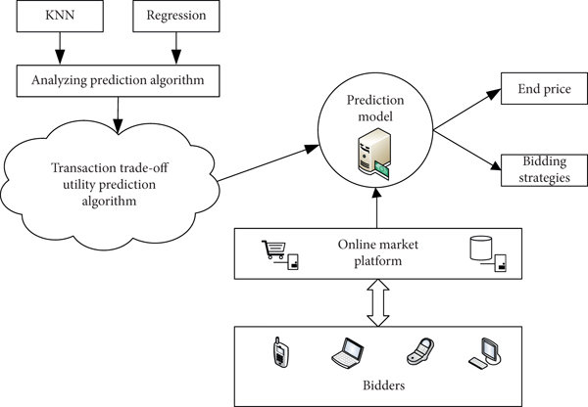
PROPOSED SYSTEM ARCHITECTURE

Slide 9
SOFTWARE AND HARDWARE REQUIREMENTS
HARDWARE
1. Processor: Minimum Intel i3 or equivalent
2. RAM: 4 GB (Minimum), 8 GB
3. Storage: 250 GB HDD / 128 GB SSD
4. Storage: 250 GB HDD / 128 GB SSD
5. Input/Output Devices: Standard keyboard, mouse, monitor
SOFTWARE
1. Front-End: HTML, CSS, JavaScript (for UI)
2. Back-End: PHP (server-side scripting)
3. Database: MySQL / MariaDB

Slide 10
MODULES
1. User & Authentication
2. Auction Listing & Management
3. Bidding System
4. Auction Completion & Confirmation
5. Notification & User Experience

Slide 11
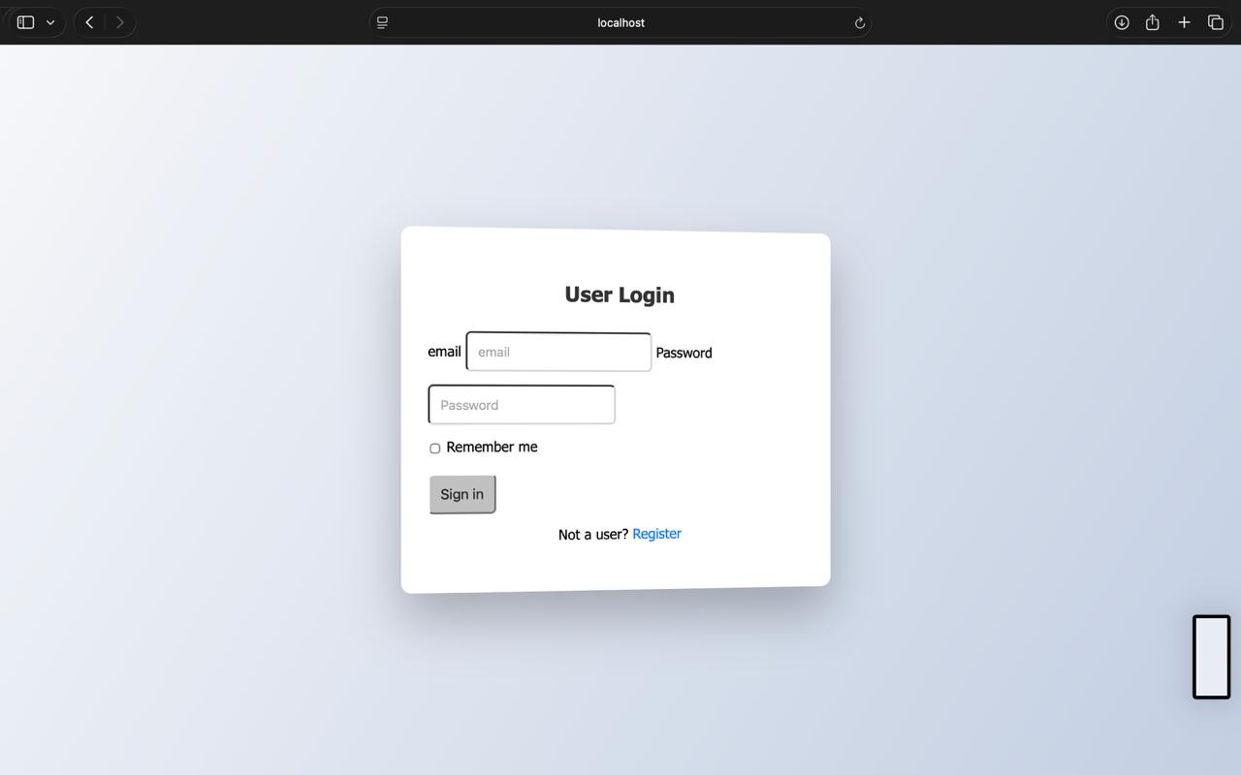
IMPLEMENTATION OF MODULE-1
User & Authentication
Handles user registration, login, and role management (Admin / Bidder).
Ensures secure access using authentication and session handling.
Validates user details before allowing participation in auctions.

Slide 12
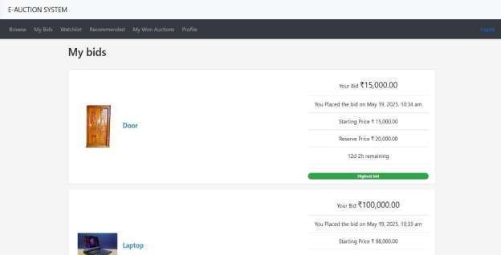
IMPLEMENTATION OF MODULE-2
Auction Listing & Management
Allows admins to create, update, or delete auction items.
Displays available auctions with item details, start/end times, and base prices.
Maintains auction data dynamically from the database.

Slide 13

IMPLEMENTATION OF MODULE-3
Bidding System
Enables registered users to place bids on active auctions.
Automatically updates the highest bid in real time or upon page refresh.
Ensures fair competition by validating bid amount and timing.

Slide 14
IMPLEMENTATION OF MODULE-4
Auction Completion & Confirmation
Determines winning bidders automatically after the auction ends.
Records and displays final results to both admin and bidders.
Generates auction result reports for admin verification.

Slide 15
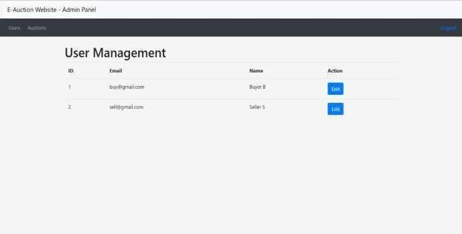
IMPLEMENTATION OF MODULE-5
Notification & User Experience
Provides feedback messages for actions like successful bids, login, or auction closure.
Can be extended to include email/SMS alerts for winners or outbids.
Focuses on a simple, interactive, and user-friendly interface.

Slide 16
CONCLUSION
1. The E-Auction System provides a modern and efficient alternative to traditional auctions.
2. By integrating real-time bidding, secure transactions, and user authentication, it ensures transparency and trust.
3. The system improves accessibility, fairness, and operational efficiency for both sellers and buyers.
4. With its automated processes and user-friendly interface, it simplifies auction management.
5. This project demonstrates how technology can revolutionize auctioning, making it more scalable and globally accessible.

Slide 17
FUTURE ENHANCEMENTS
1. Real-Time Bidding System:
Integrate live bidding using WebSocket's or AJAX to update bid prices instantly without refreshing the page.
2. AI-Based Price Prediction:
Use machine learning to analyze past auction data and predict expected bid ranges or market value for items.
3. User Notifications:
Implement email/SMS alerts to notify bidders when they are outbid or when auctions are about to close.
4. Secure Payment Gateway Integration:
Add payment features for direct transactions after auction completion using gateways like Razor pay or PayPal.

